Slide 1
WEB PROGRAMIRANJE 1 Dokumentacija URL:
https://sanja14pavlovic.github.io/JSsite.github.io/contact.html
12/21 Sanja Pavlovic

Slide 2
Sadrzaj
Uvod
Korisceni programski jezici
Opis funkcionalnosti
Template
Organizacija:
Sema sajta
Mapa sajta
Slike stranica
Kodovi:
HTML
CSS
JavaScript

Slide 3
Korisceni jezici
HTML
CSS
JavaScript
XML
JQuery
Bootstrap 5.0.2

Slide 4
Opis funkcionalnosti
Strelica za povratak na vrh stranice
Dinamicki ispisan meni
Dinamicki ispisan about me
Provera forme
JQery u about us
Dinamicki ispisan footer
Filtriranje menija

Slide 5
Template
Preuzet sa sajta:
https://www.free-css.com/free-css-templates/page287/cakezone

Slide 6
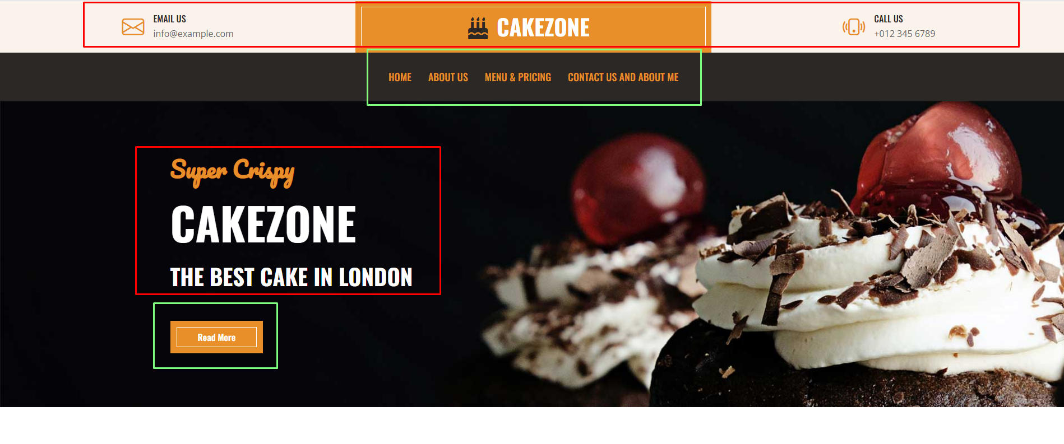
Zelenom bojom dinamicki ispisane stvari, crvenom preuzeto
Odradjena izmena teksta i uklanjanje dodatnog buttona, povezivanje postojeceg

Slide 7
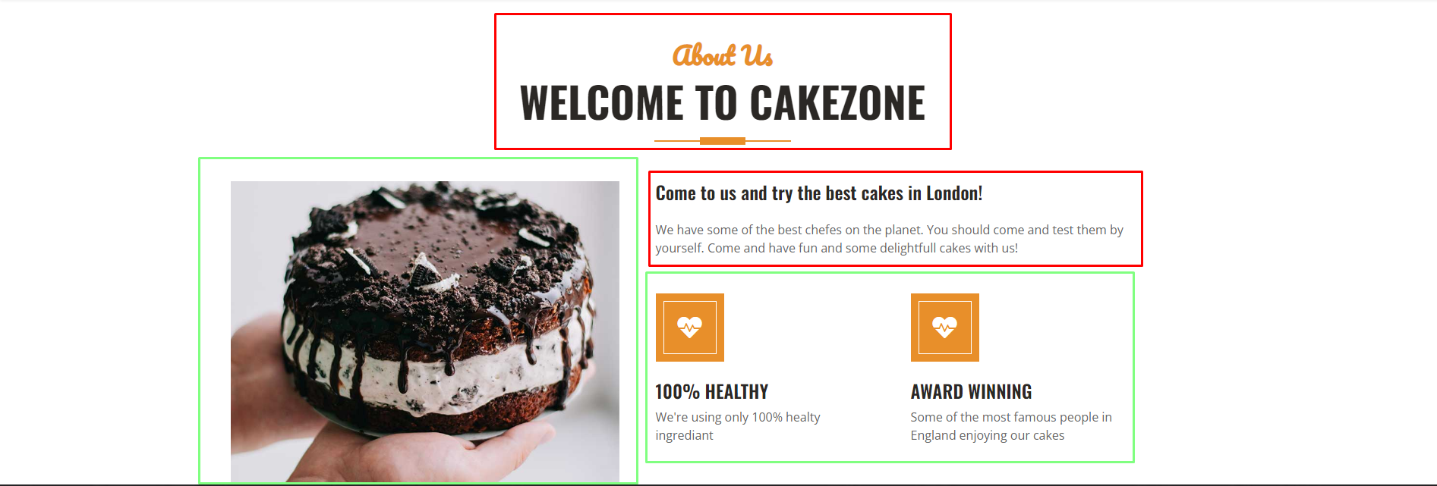
jQuery za promenu slike

Slide 8

Dinamicki ispisano

Slide 9
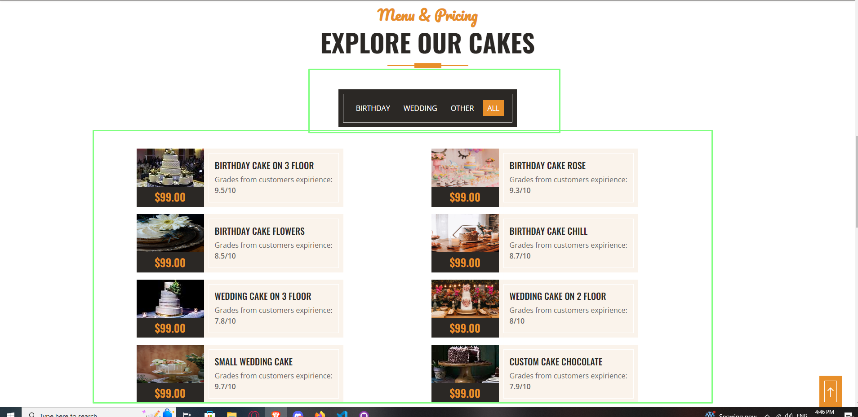
Filter

Slide 10


Slide 11
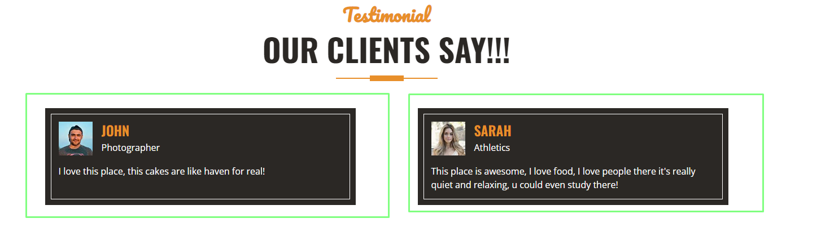

Slide 12
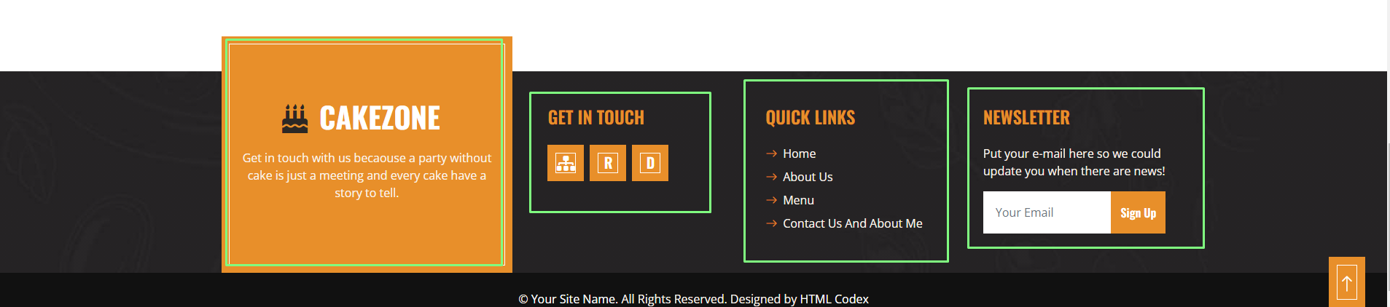
Dinamicki ispis i izmene teksta

Slide 13
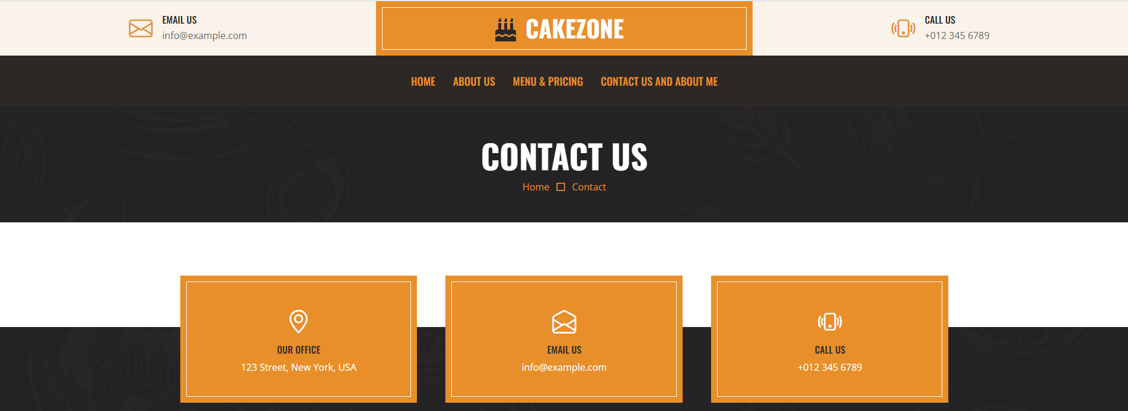
Promene teksta, linkova i dinamicki ispis blokova

Slide 14
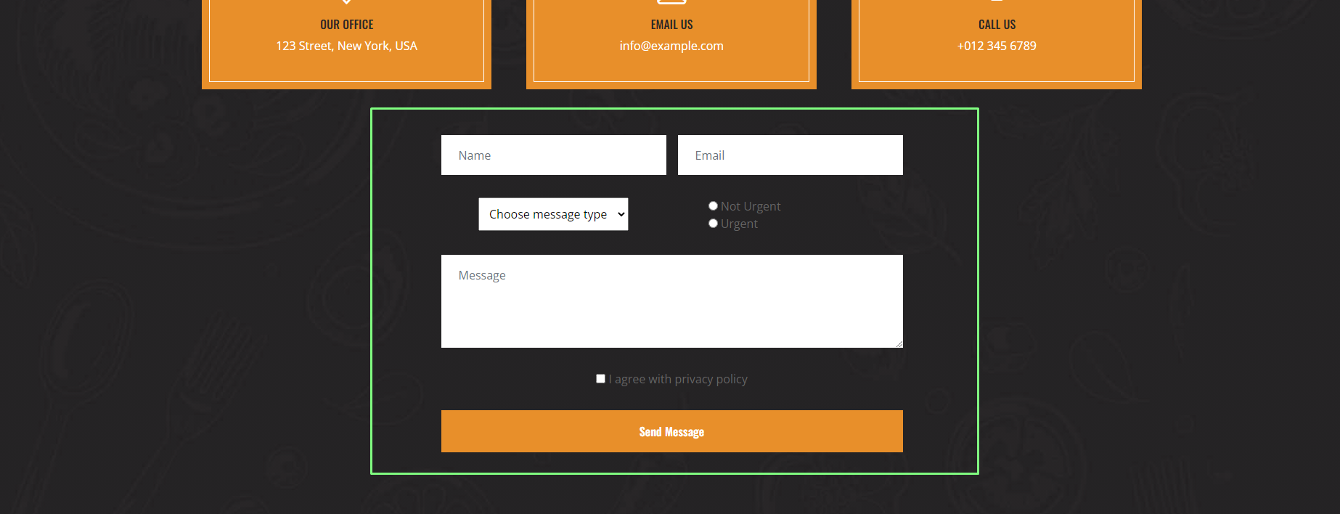
Dodatne forme i provera

Slide 15
Organizacija
2 stranice: index.html i contact.html

Slide 16
Mapa sajta
https://sanja14pavlovic.github.io/JSsite.github.io/sitemap.xml

Slide 17
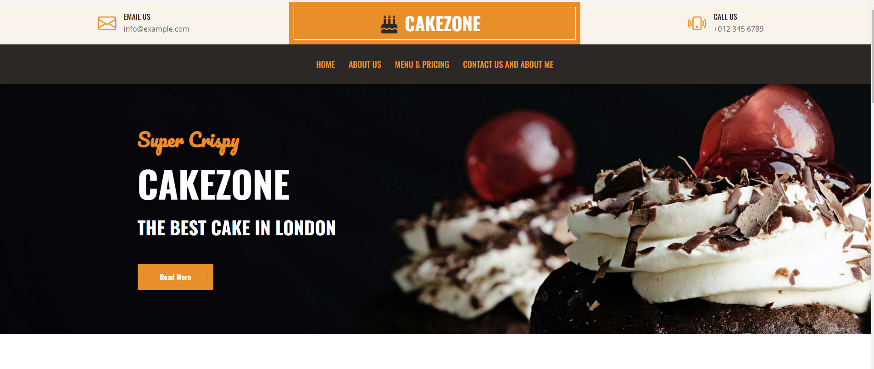
Organizacija i sadrzaj
Pocetna stranica sadrzi meni, logo i button kojim se dolazi do vise informacija

Slide 18
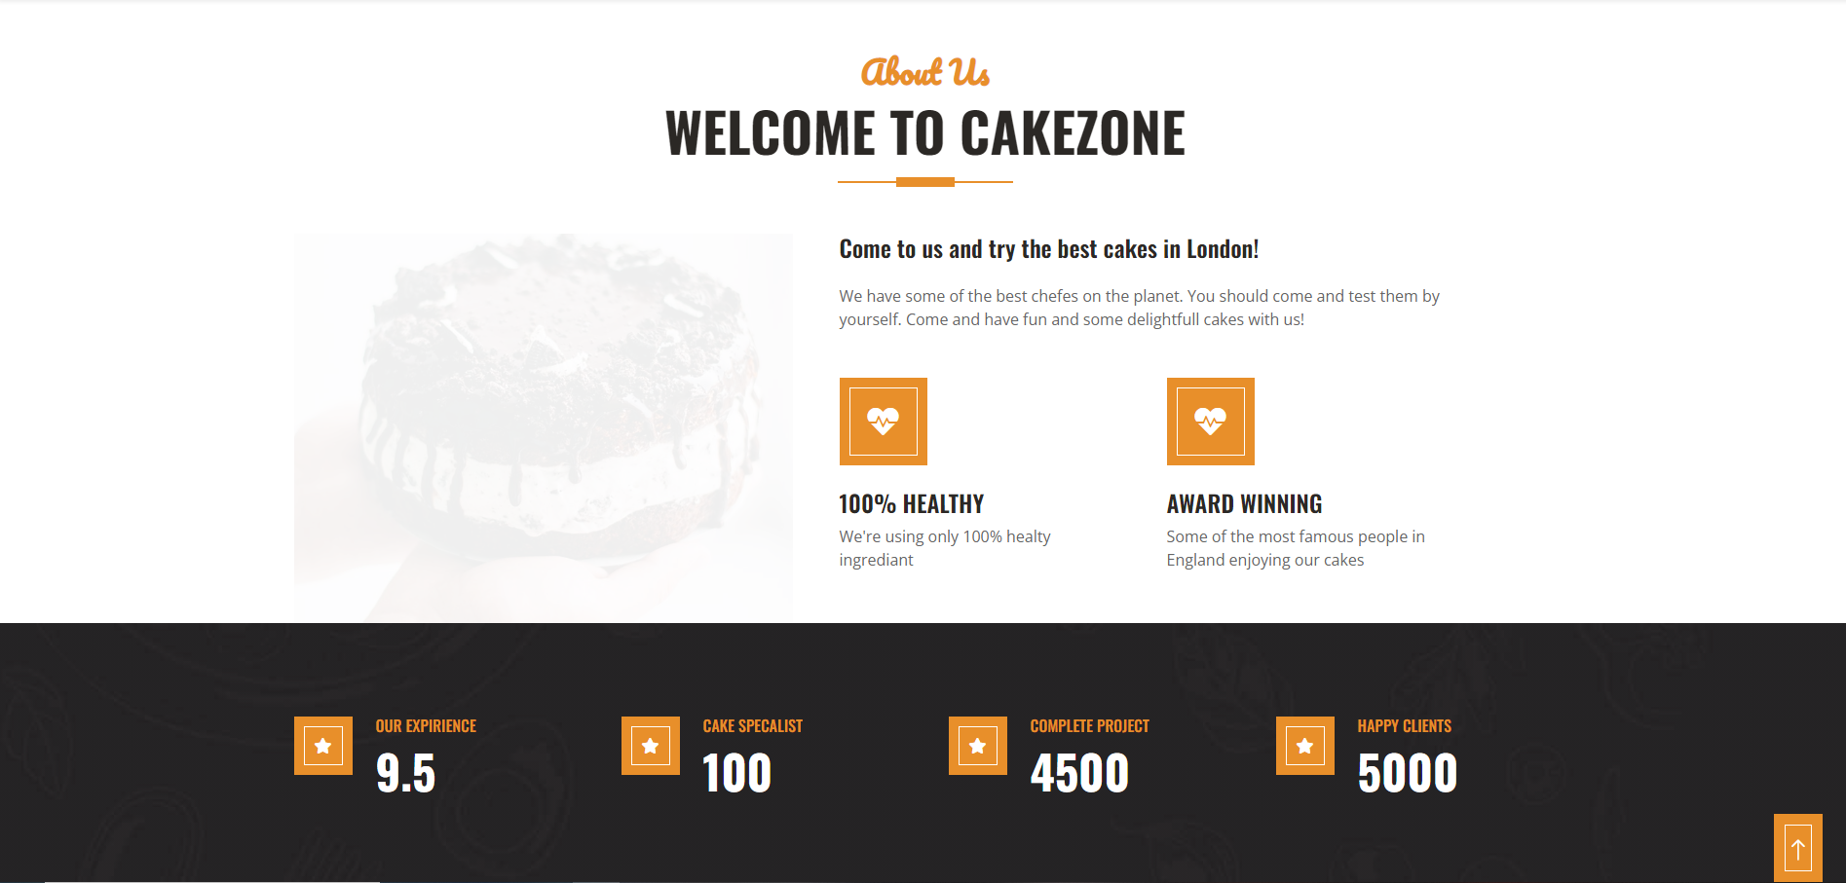
About us sadrzi ukratke i najbitnije informacije o sajtu

Slide 19
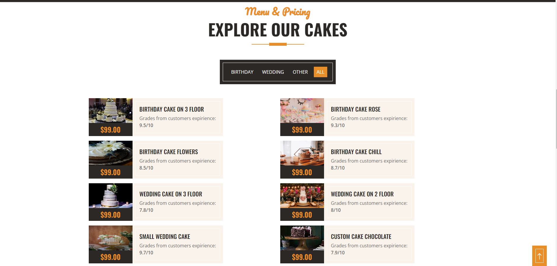
Meni sadrzi filter i dostupne prozivode za kupovinu

Slide 20

"Reklama" koja sadrzi informacije o specijalitetu

Slide 21
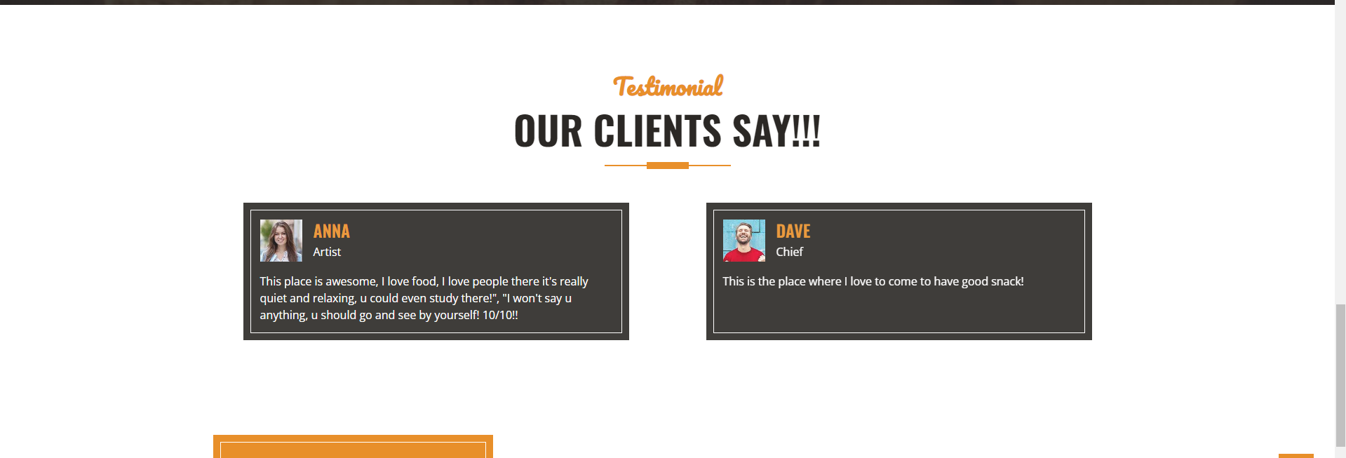
Utisci klijenata

Slide 22

Futer sa menijem i linkovima ka sitemap-u, robots-u i dokumentaciji

Slide 23
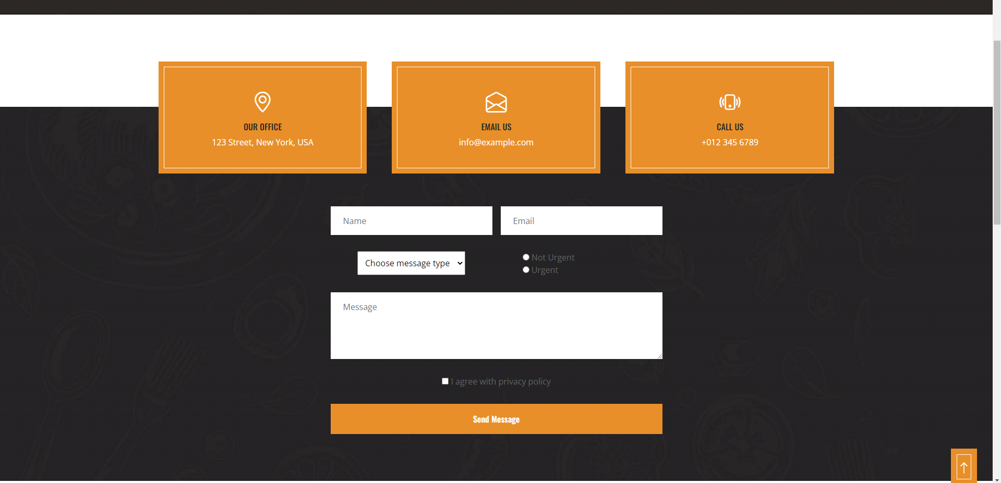
Kontakt sadrzi formu i proveru forme

Slide 24
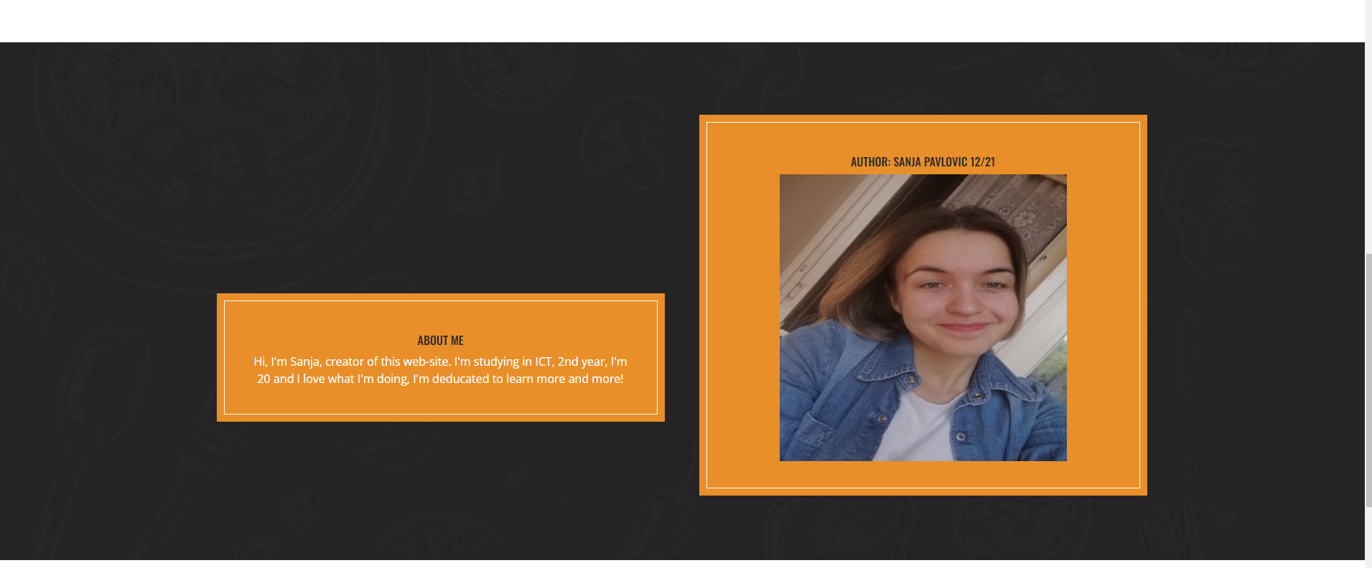
About me sadrzi podatke o autoru

Slide 25

Futer kontakt stranice isti kao i index stranice

Slide 26
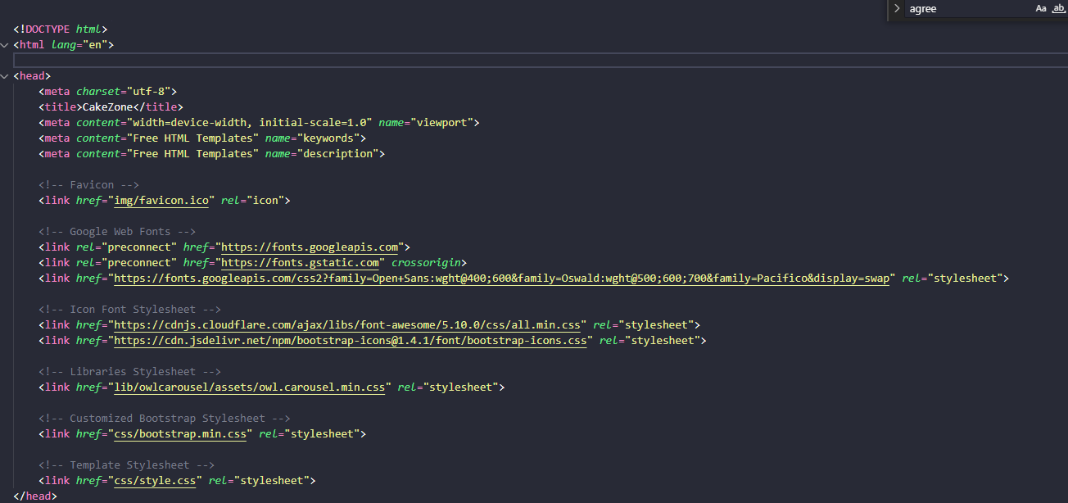
Index.html kod

Slide 27
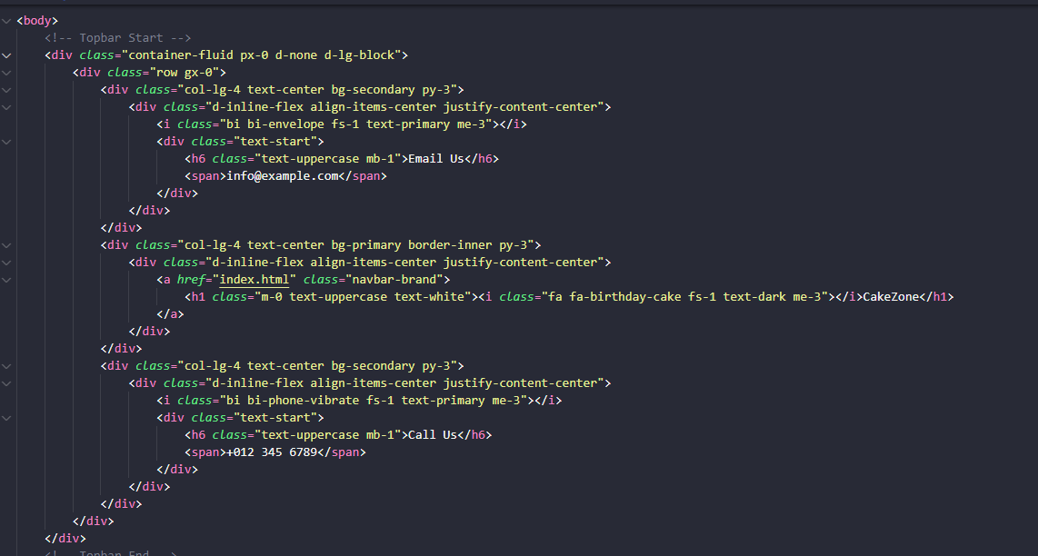

Slide 28
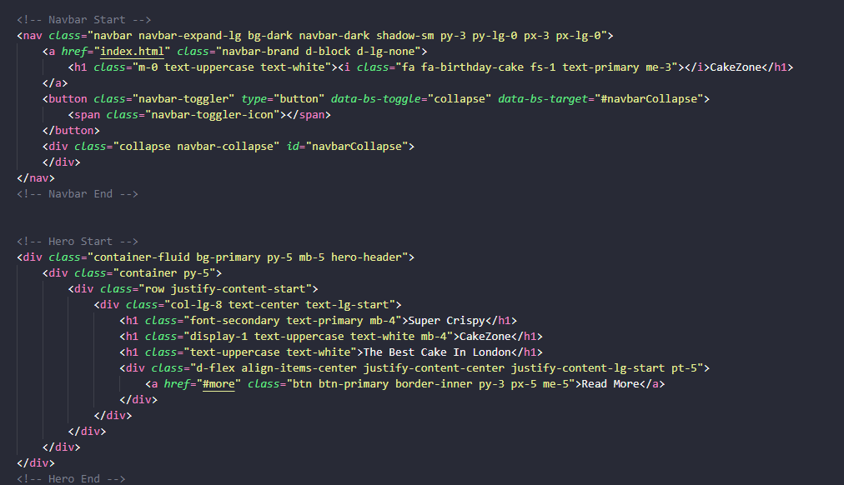

Slide 29
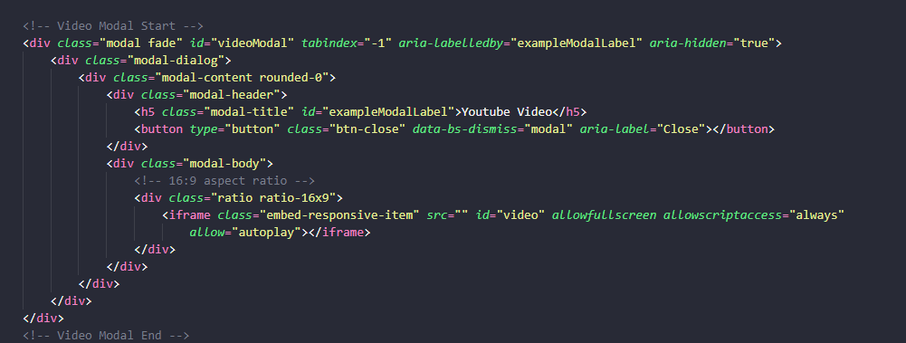
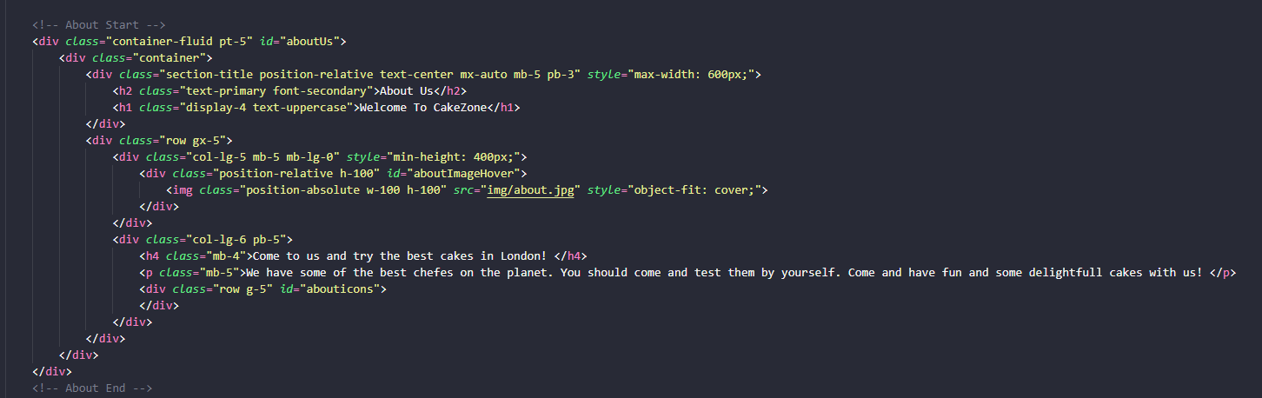

Slide 30
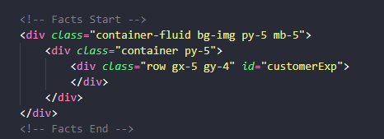
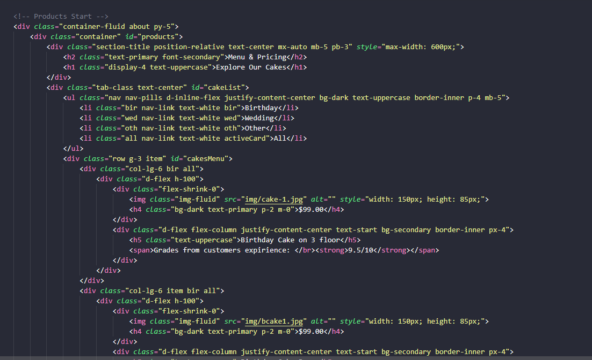

Slide 31
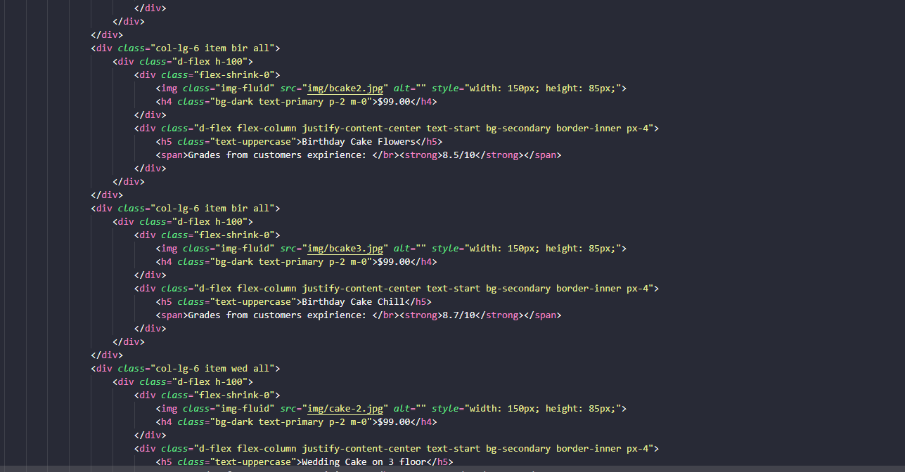
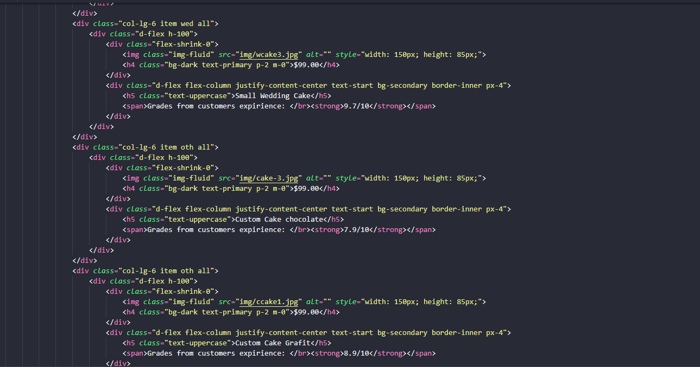

Slide 32
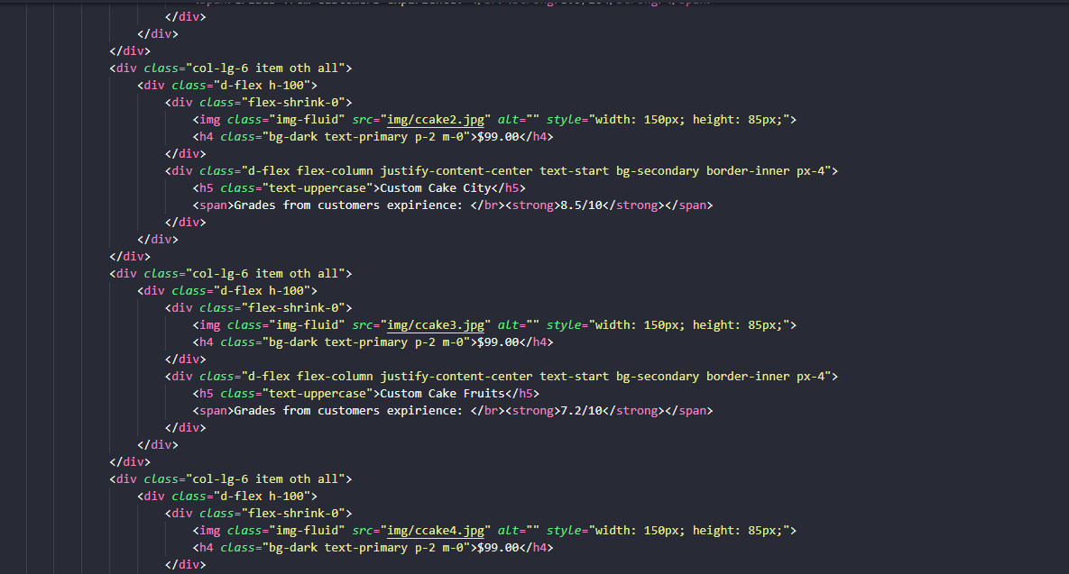
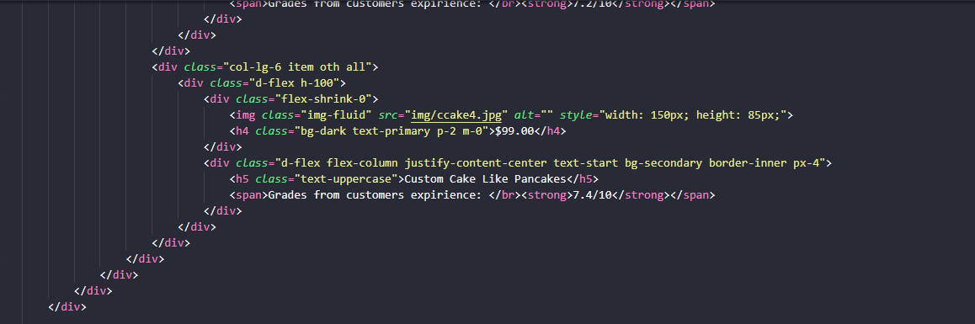

Slide 33
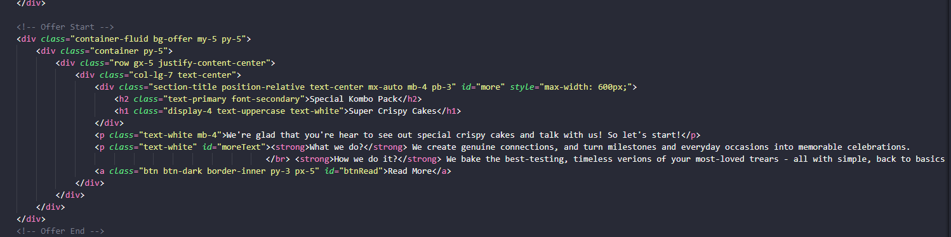
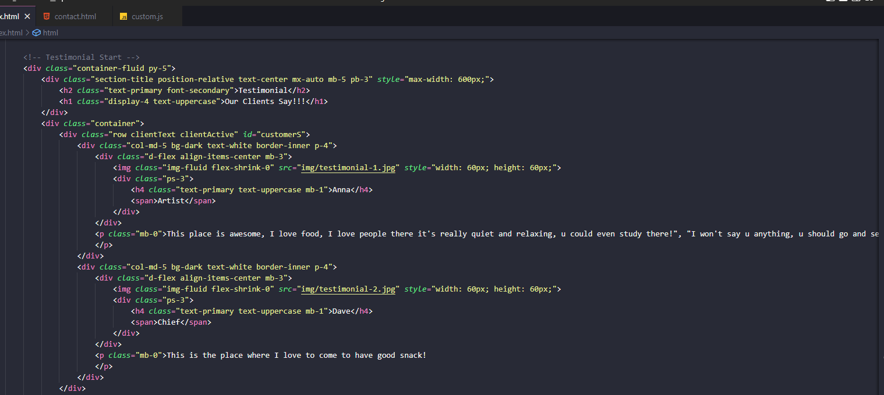

Slide 34
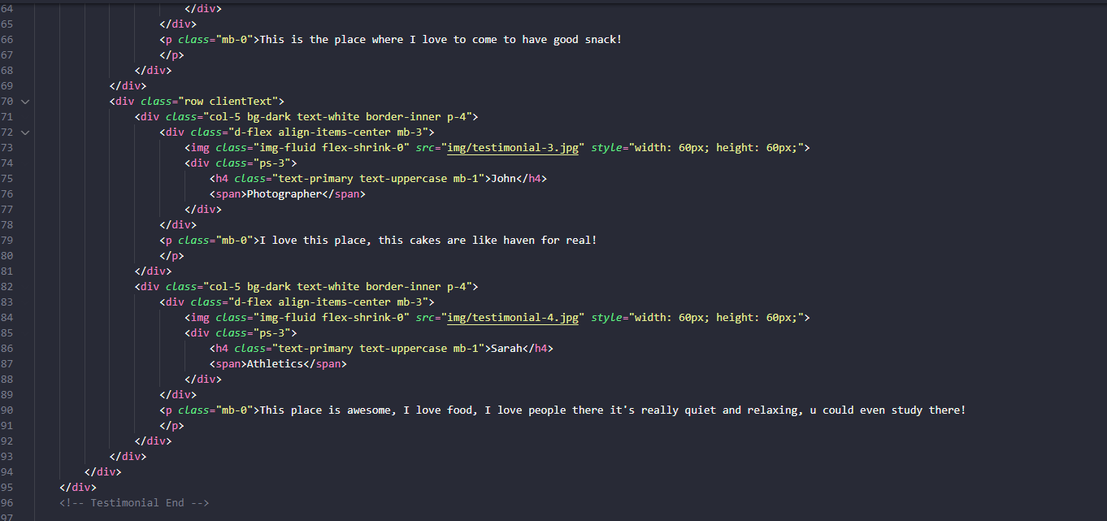

Slide 35
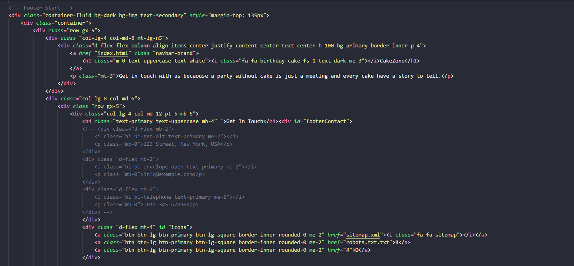

Slide 36
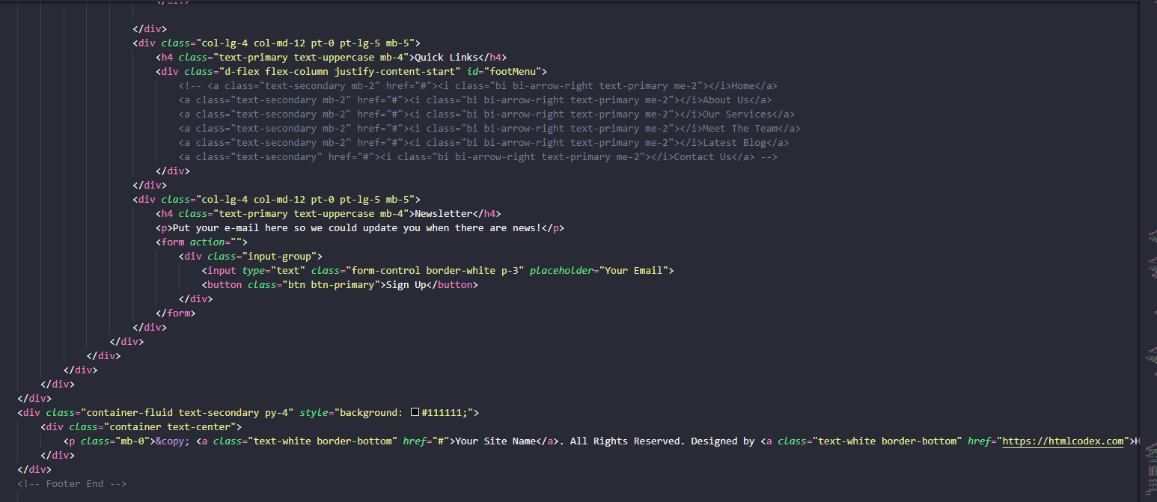

Slide 37
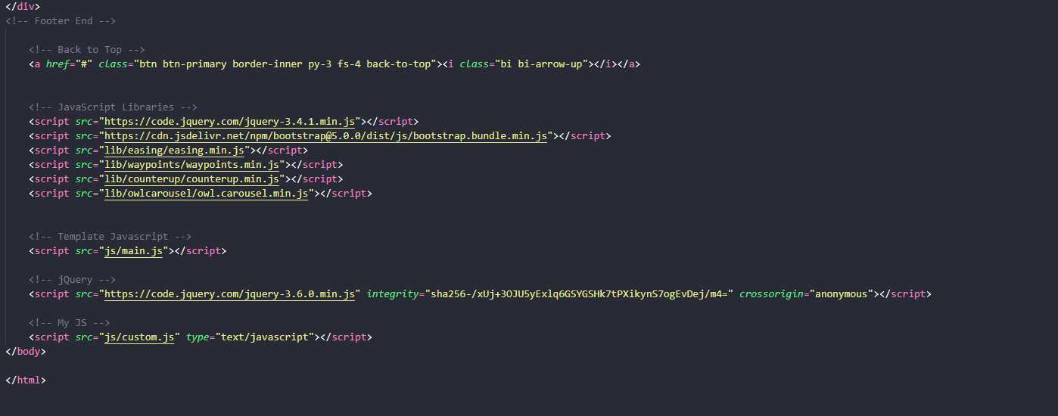

Slide 38
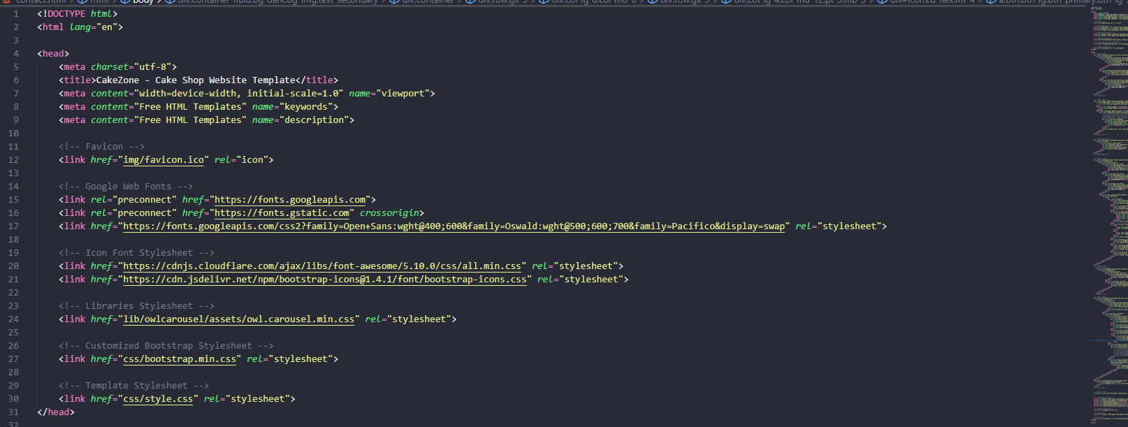
Contact.html

Slide 39
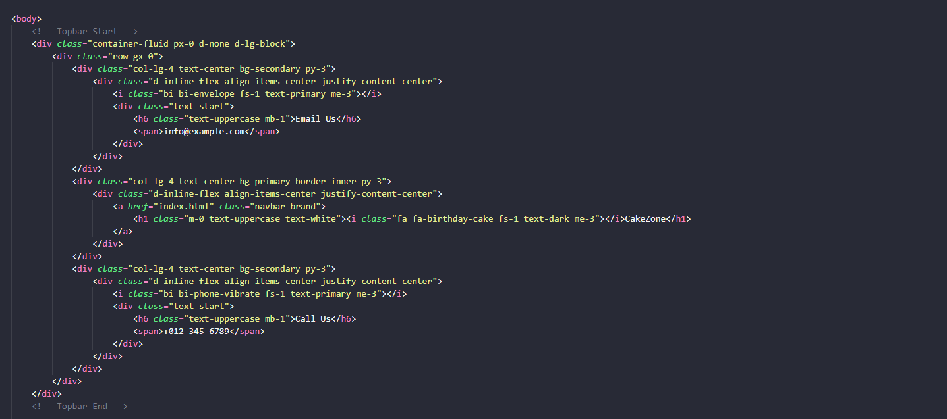

Slide 40
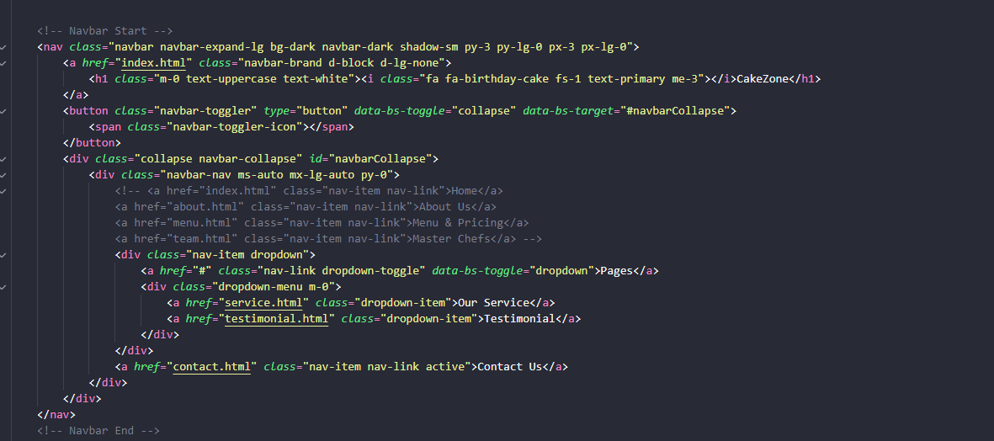
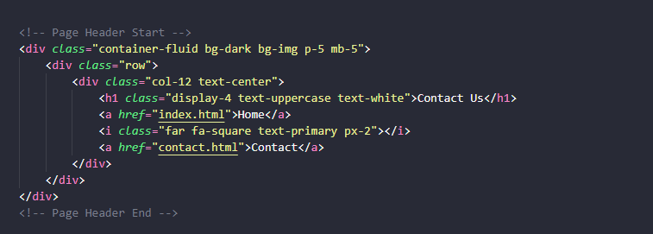

Slide 41
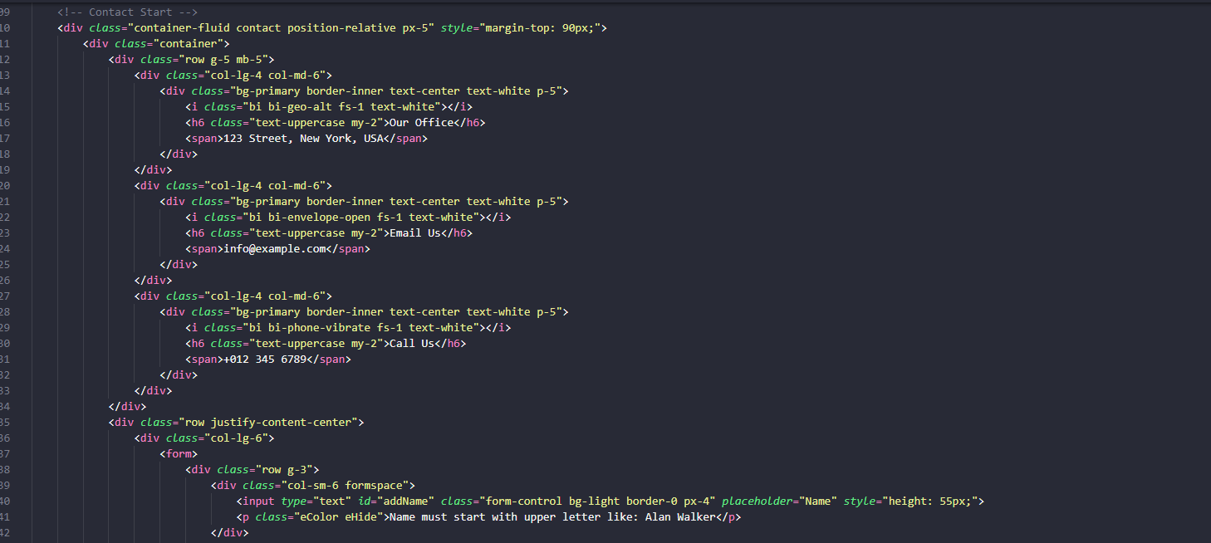

Slide 42
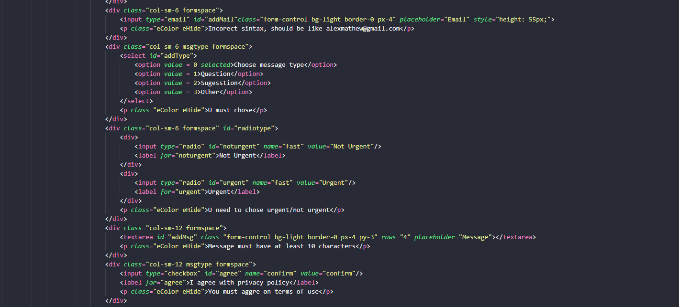

Slide 43
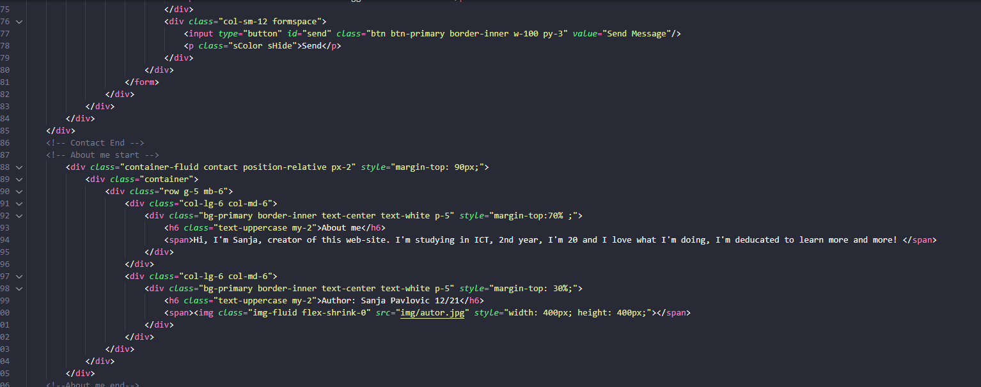

Slide 44
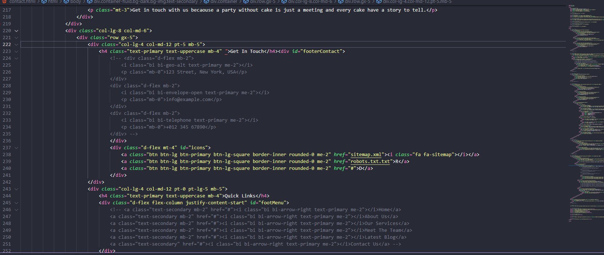
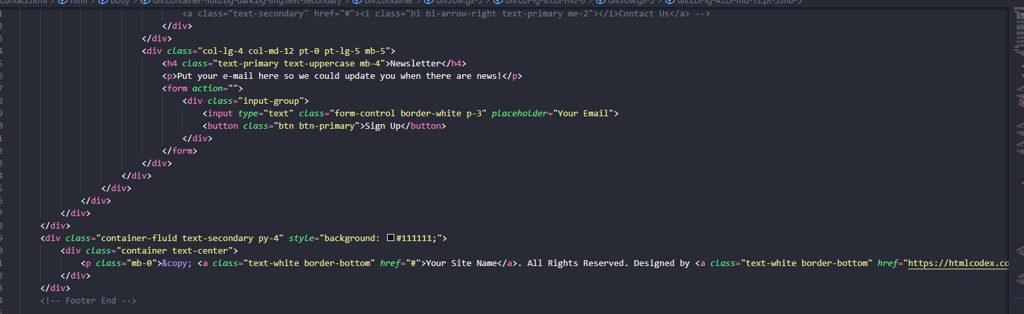

Slide 45
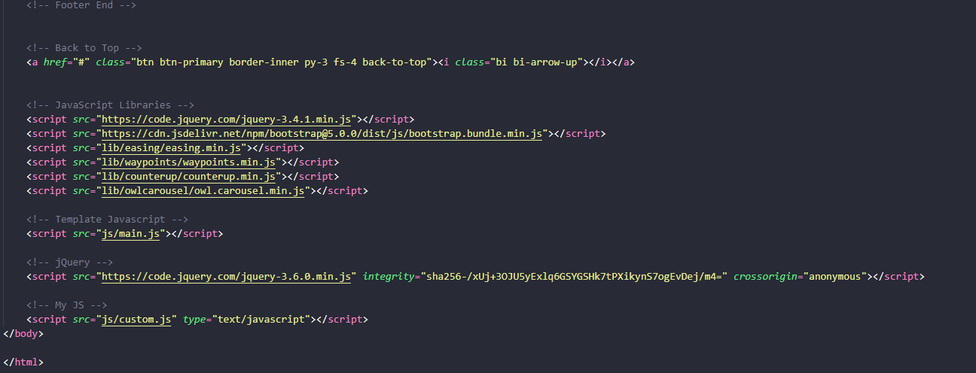

Slide 46
custom.js
/Globalno
var path = window.location.pathname.split("/").pop();
let links = ["index.html", "../#aboutUs", "../#products", "contact.html"];
let pageNames = ["Home", "About Us", "Menu & Pricing", "Contact Us And About Me"];
var writeMenu = `<div class="navbar-nav ms-auto mx-lg-auto py-0">`
for(let i=0; i<links.length; i++){
writeMenu += `<a href="${links[i]}" class="nav-item nav-link active">${pageNames[i]}</a>`;
}
writeMenu += `</div>`;
document.querySelector("#navbarCollapse").innerHTML = writeMenu;
let footerMenuText= ["Home", "About Us", "Menu", "Contact Us And About Me"];
let footerMenuLink= ["Index.html","#aboutUs", "#products", "contact.html"];
let footerMenuWrite="";
for(let i=0; i<footerMenuLink.length; i++){
footerMenuWrite+= `<a class="text-secondary mb-2" href="${footerMenuLink[i]}"><i class="bi bi-arrow-right text-primary me-2"></i>${footerMenuText[i]}</a>`
}
document.querySelector("#footMenu").innerHTML=footerMenuWrite;

Slide 47
//Indeks
if(path =="index.html" || path == ""){
//Promena slike
$("#aboutImageHover img").hover(function(){
$(this).fadeOut(function(){
$(this).attr("src","img/cake-for-about.jpg").fadeIn();
})
},
function(){
$(this).fadeOut(function(){
$(this).attr("src","img/about.jpg").fadeIn();
})
})
//Promocija
let aboutIconsText = ["100% Healthy", "Award Winning"];
let aboutTextIcons = ["We're using only 100% healty ingrediant","Some of the most famous people in England enjoying our cakes"];
var aboutIcons = "";
for (let i =0; i<aboutIconsText.length; i++){
aboutIcons += `<div class="col-sm-6">
<div class="d-flex align-items-center justify-content-center bg-primary border-inner mb-4" style="width: 90px; height: 90px;">
<i class="fa fa-heartbeat fa-2x text-white"></i>
</div>
<h4 class="text-uppercase">${aboutIconsText[i]}</h4>
<p class="mb-0">${aboutTextIcons[i]}</p>
</div>`
}
document.querySelector("#abouticons").innerHTML = aboutIcons;

Slide 48
//Statistika
let customerText= ["OUR EXPIRIENCE", "CAKE SPECALIST", "COMPLETE PROJECT", "HAPPY CLIENTS"]
let customerCounter = ["9.5", "100", "4500", "5000"]
var customersExpirience = "";
for(let i=0; i<customerText.length; i++){
customersExpirience += `<div class="col-lg-3 col-md-6">
<div class="d-flex">
<div class="bg-primary border-inner d-flex align-items-center justify-content-center mb-3" style="width: 60px; height: 60px;">
<i class="fa fa-star text-white"></i>
</div>
<div class="ps-4">
<h6 class="text-primary text-uppercase">${customerText[i]}</h6>
<h1 class="display-5 text-white mb-0" data-toggle="counter-up counter">${customerCounter[i]}</h1>
</div>
</div>
</div>`
}
document.querySelector("#customerExp").innerHTML = customersExpirience;
//Filter
$("#cakeList ul li").click(function(){
var iteClass = $(this).attr("class").substring(0,3);
console.log(iteClass);
$(".item .all").hide();
$(".item ." + iteClass).show();
$(this).siblings(".activeCard").removeClass("activeCard");
$(this).addClass("activeCard");
})

Slide 49
//Citaj jos
$("#btnRead").click(function(){
if($("#moreText").is(":visible")){
$("#moreText").fadeOut().hide();
}
else{
$("#moreText").fadeIn().show();
}
})
//Klijenti
$(document).ready(function(){
changeCients();
});
function changeCients(){
var curClients = $(".clientActive");
if(curClients.next().length){
var nextClients = curClients.next()
}
else{
var nextClients = curClients.parent().children(":first");
}
curClients.hide().removeClass("clientActive");
nextClients.fadeIn(2500).addClass("clientActive");
setTimeout(changeCients,5000);
}
}

Slide 50
//Kontakt
if(path == "contact.html"){
//Regularni izrazi
var regMail = /^[a-z]+([\.]?[a-z]*[\d]*)*\@[a-z]+([\.]?[a-z]+)*(\.[a-z]{2,3})+$/
var regName = /^([A-Z][a-z]{2,10})\s([A-Z][a-z]{3,15})$/
var regMsg = /(.{10})+/
//Provera forme
var conName = document.querySelector("#addName");
conName.addEventListener("blur",function(){
formCheck(regName,conName);
})
var conMail = document.querySelector("#addMail");
conMail.addEventListener("blur",function(){
formCheck(regMail,conMail);
})
var conMsg = document.querySelector("#addMsg");
conMsg.addEventListener("blur",function(){
formCheck(regMsg,conMsg);
})
var conSel = document.querySelector("#addType");
conSel.addEventListener("change",function(){
var conSelected = conSel.options[conSel.selectedIndex].value;
if(conSelected == 0){
conSel.nextElementSibling.classList.remove("eHide");
conSel.nextElementSibling.classList.add("eShow");
}
else{
conSel.nextElementSibling.classList.remove("eShow");
conSel.nextElementSibling.classList.add("eHide");
}
})

Slide 51
var conRadio = document.getElementsByName("fast");
conRadio.forEach(element => element.addEventListener("change",function(){
for(let i= 0; i <conRadio.length; i++){
if(conRadio[i].checked){
conRadio[1].parentElement.nextElementSibling.classList.remove("eShow");
conRadio[1].parentElement.nextElementSibling.classList.add("eHide");
break;
}
else{
conRadio[1].parentElement.nextElementSibling.classList.remove("eHide");
conRadio[1].parentElement.nextElementSibling.classList.add("eShow");
}
}
}))
var conCheck = document.querySelector("#agree");
conCheck.addEventListener("change",function(){
if(conCheck.checked){
conCheck.nextElementSibling.nextElementSibling.classList.remove("eShow");
conCheck.nextElementSibling.nextElementSibling.classList.add("eHide");
}
else{
conCheck.nextElementSibling.nextElementSibling.classList.remove("eHide");
conCheck.nextElementSibling.nextElementSibling.classList.add("eShow");
}
})

Slide 52
var conBtn = document.querySelector("#send");
conBtn.addEventListener("click",function(){
var eBr = 0;
var p = 1;
var conSelected = conSel.options[conSel.selectedIndex].value;
if(conSelected == 0){
conSel.nextElementSibling.classList.remove("eHide");
conSel.nextElementSibling.classList.add("eShow");
p=1;
}
else{
conSel.nextElementSibling.classList.remove("eShow");
conSel.nextElementSibling.classList.add("eHide");
p=0;
}
eBr += p;
p=1;
for(let i= 0; i <conRadio.length; i++){
if(conRadio[i].checked){
conRadio[1].parentElement.nextElementSibling.classList.remove("eShow");
conRadio[1].parentElement.nextElementSibling.classList.add("eHide");
p=0;
break;
}
else{
conRadio[1].parentElement.nextElementSibling.classList.remove("eHide");
conRadio[1].parentElement.nextElementSibling.classList.add("eShow");
p=1;
}
}
eBr += p;
p=1;
if(conCheck.checked){
conCheck.nextElementSibling.nextElementSibling.classList.remove("eShow");
conCheck.nextElementSibling.nextElementSibling.classList.add("eHide");
p=0;
}
else{
conCheck.nextElementSibling.nextElementSibling.classList.remove("eHide");
conCheck.nextElementSibling.nextElementSibling.classList.add("eShow");
p=1;
}
eBr += p;;
eBr += formCheck(regName,conName);
eBr += formCheck(regMail,conMail);
eBr += formCheck(regMsg,conMsg);
if(!eBr){
conBtn.nextElementSibling.classList.remove("sHide");
conBtn.nextElementSibling.classList.add("sShow");
}
})
}

Slide 53
//Functions
function formCheck(reg,val){
if(reg.test(val.value)){
val.nextElementSibling.classList.remove("eShow");
val.nextElementSibling.classList.add("eHide");
return 0;
}
else{
val.nextElementSibling.classList.remove("eHide");
val.nextElementSibling.classList.add("eShow");
return 1;
}
}

